Slide 1


Slide 2

What is the difficulties you faced it when you classified glycoside??
In which step all glycoside participate in biosynthesis pathway?

Slide 3

Detect the sugar abundant in plant glycoside?

Slide 4
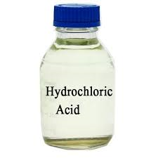
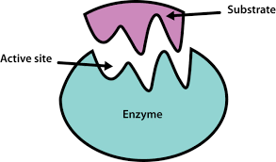

What is the best way to hydrolyzed glycoside ?
Acid OR Enzyme
and why???

Slide 5
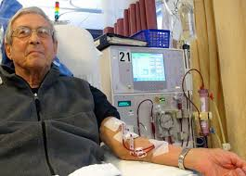

From information in previous lecture can you guide patient suffering
from leukemia to special natural treatment? If you can guide him why
you choose this naturel remedy ??

Slide 6
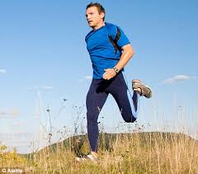
I am healthy person, As pharmacist do you think , Antioxidant is important for me or not ??
Well if your answer yes can you guide me to the natural antioxidant???

Slide 7

What is free radical ??? How its formed????
Its safe OR not ???
What is the relationship between free radical & antioxidant?
Where is antioxidant formed???

Slide 8

Can you recognize the name of aglycon part from the name of its glycoside????

Slide 9
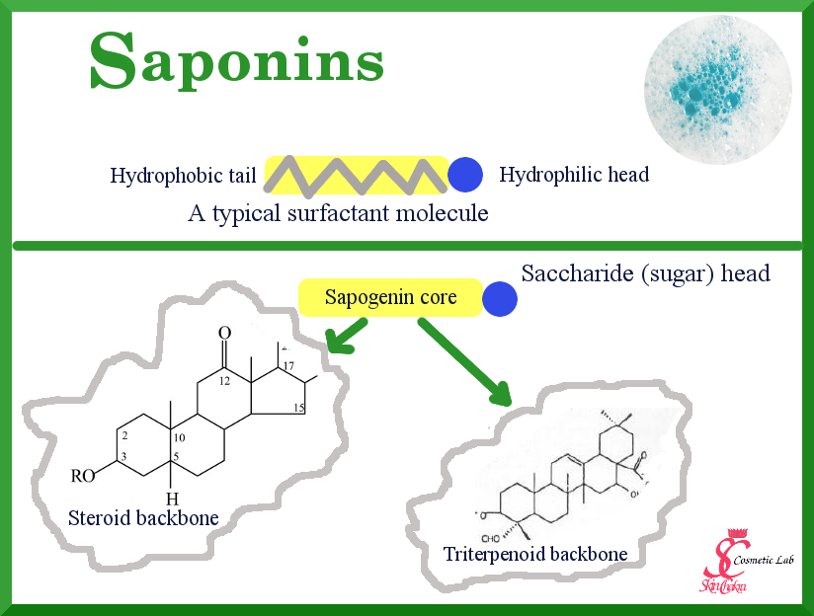

Slide 10
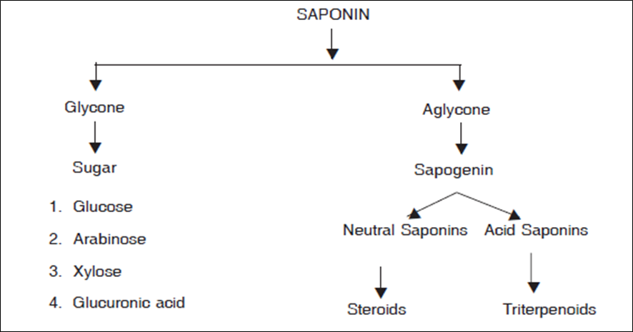

Slide 11
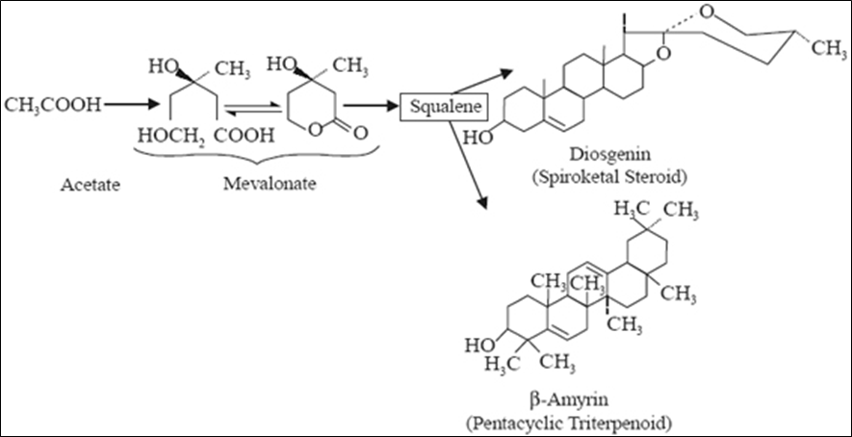

Slide 12
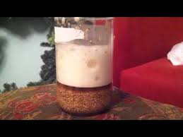
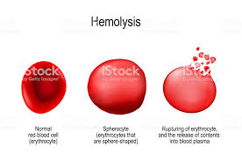
Saponin glycosides properties :
Bitter, acrid taste and irritant to mucous membrane
In an aqueous solution froths when shaken
An aqueous solution, shaken with oil and fats, produces emulsion, which stable for a short time, varying from a few minutes to an hour or more. Emulsification is caused by the saponin lowering the surface tension between the oil and the water.
Destroy RBCs cause blood haemolysis. Toxic by i.v injection .

Slide 13
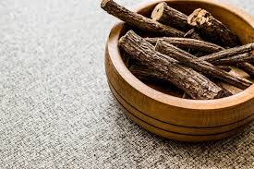
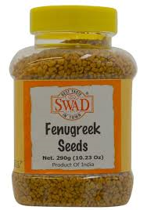
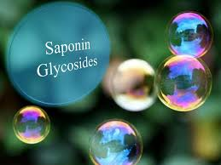
Bioactivity of Saponin Glycosides
SPGs have a diverse range of activities, which include the previously mentioned foaming and emulsifying properties, hemolytic properties as well as sweetness (licorice saponins) and . As surface active compounds in aqueous solutions, they form micelles as concentration reaches a critical level. They have solubilization properties for other compounds and can be used to enhance penetration of macromolecules such as proteins through cell membranes. Saponins have found wide applications in beverages and confectionery, as well as in cosmetics

Slide 14
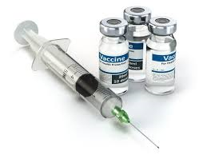
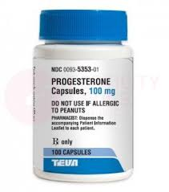
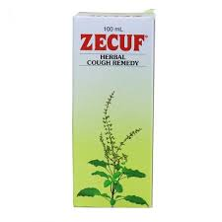
pharmaceutical products ,e.g., as adjuvants in vaccines [An adjuvants is a substance that is formulated as part of a vaccine to enhance its ability to induce protection infection].
Steroidal saponins, e.g., diosgenin from fenugreek seeds or tubers of Dioscorea villosa L.(Dioscoreaceae) are suitable precursors of partial synthesis of steroid hormones such as cortisone, progesterone

Slide 15
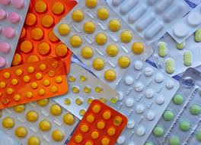
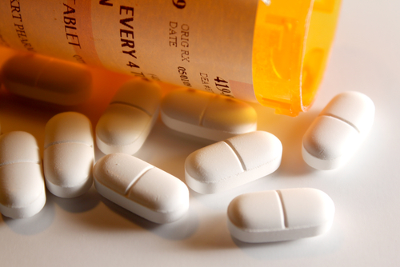
Pharmaceutical Applications of Saponin Glycosides
Many new derivatives of plant saponins were synthesized and evaluated based on their different activities. For example, Carbenxolone [Carbenoxolone is an agent derived from licorice root. It is used for the treatment of digestive tract ulcers, especially in the stomach].

Slide 16
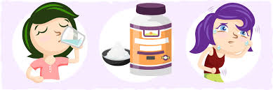
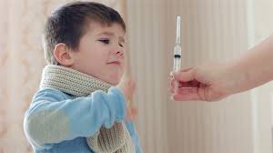
Adverse Effects of Saponin Glycosides :
Many saponin glycosides exhibit toxic effects at high doses over an extended period, causing problems such as excessive salivation, diarrhea, vomiting, loss of appetite, and manifestations of paralysis . Oral toxicity of saponins in warm-blooded animals is relatively low due to its low absorption from the intestinal tract (opposite to high toxicity for most cold-blooded animals, e.g., fish). However, saponins are gastrointestinal irritants and in milder examples, this can lead to esophageal reflux in sensitive or overweight patients. The low availability of saponins due to the intestinal tract, results in insignificant toxicity. However, they are highly toxic when given intravenously.

Slide 18
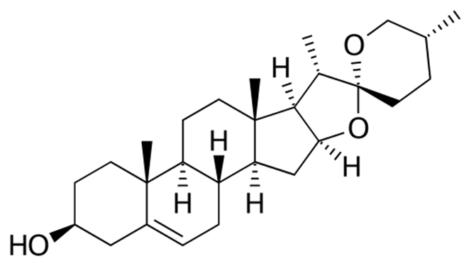
Diosgenin

Slide 20
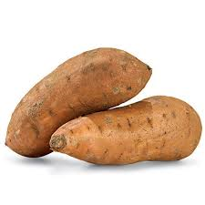
3- Dioscorea sp.
Synonym: Yam
Biological source: It is dried tubers of Dioscorea floribunda
Family: Dioscoreaceae
Steroidal saponins were reported to be the major physiologically active constituents in yams. steroidal saponins yield diosgenin (the aglycon of the yam steroidal saponin) from hydrolysis of yam saponins. Dios-genin is used as an industrial starting material for the partial synthesis of steroidal-based drugs, e.g., progesterone and testosterone .

